Slide 1
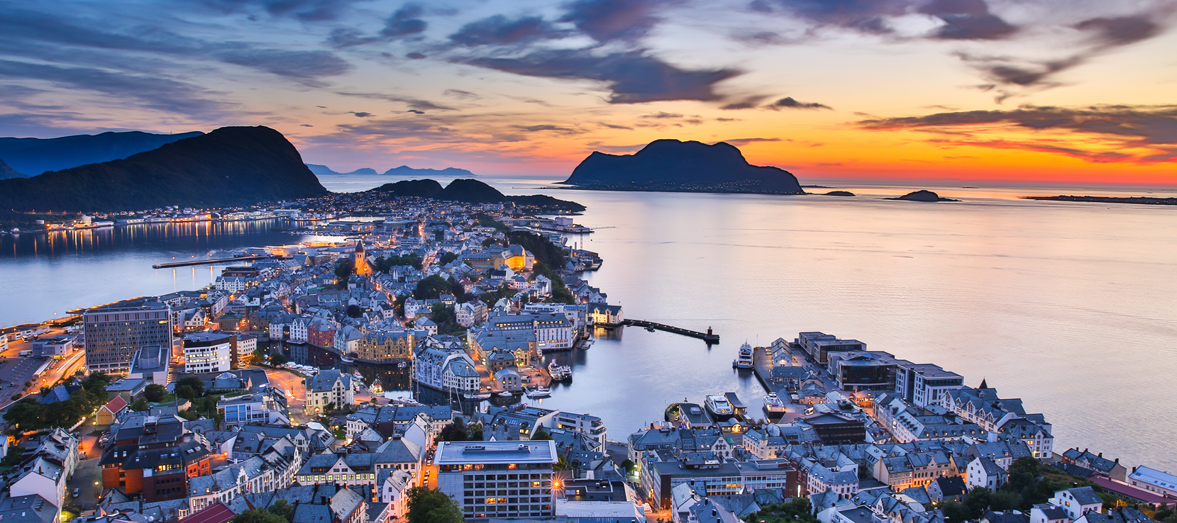
Presentation
2nd quarter 2018
Sparebanken Møre
- the Group
15. August 2018
Runar Sandanger
EVP

Slide 2
Contents
Introduction and highlights
Results
Deposits and Loans
Liquidity and Capital
Main targets

Slide 3
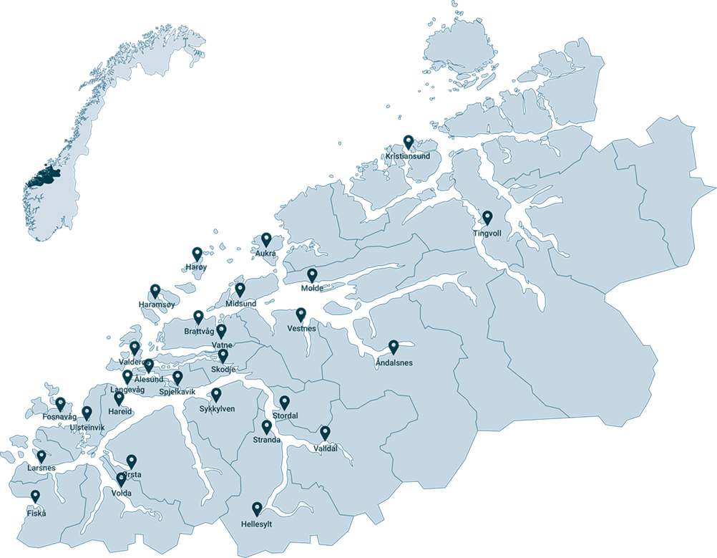
The largest bank in the county
Strong local presence
28
OFFICES IN
Møre og Romsdal
356
Man YearS
70.6
Billion in
TOTAL ASSETS

Slide 4
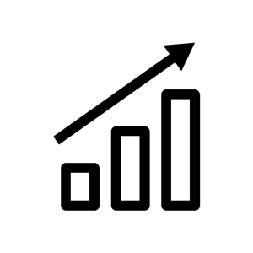



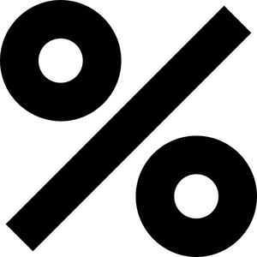
Highlights from H1 2018
Positive development in key figures
Strong loan growth: 5.0 per cent over the last 12 months
High and stable Net Interest Income: Growth both in NOK and in per cent compared to the same period last year
High efficiency: Cost/Income ratio at 42.1 per cent by half year end – down 3.6 p.p. compared with first two quarters last year
Very low losses: Net NOK 3 million in loan loss reversals in H1 2018
Strong liquidity and solidity: Deposit to Loan ratio at 58.2 per cent, CET1 at 15.5 per cent
Good Return on Equity: 11.2 per cent

Slide 5
Key figures
We reach our goals
Return on Equity
Cost/Income
Losses on Loans and Guarantees
Common Equity Tier1 Capital (CET1)

Slide 6

Positive outlook
Sparebanken Møre is well capitalized and has a very good liquidity by half year end. The bank has a healthy financial structure and a strong balance sheet. The results have been strong and stable and losses have been at a low level for many years
The economic outlook for Møre og Romsdal is still good. Going forward, we expect an increase in production and employment in most sectors and industries. The main reasons for this are
  a weak Norwegian currency
  low level of interest rates
  expansionary fiscal policy
  high oil prices
  good growth in our export markets
  high adaptability in local business and industry
It also appears that the danger of a major fall in house prices has been reduced. However, the risk of growth-dampening international trade barriers seems to have increased somewhat

Slide 7
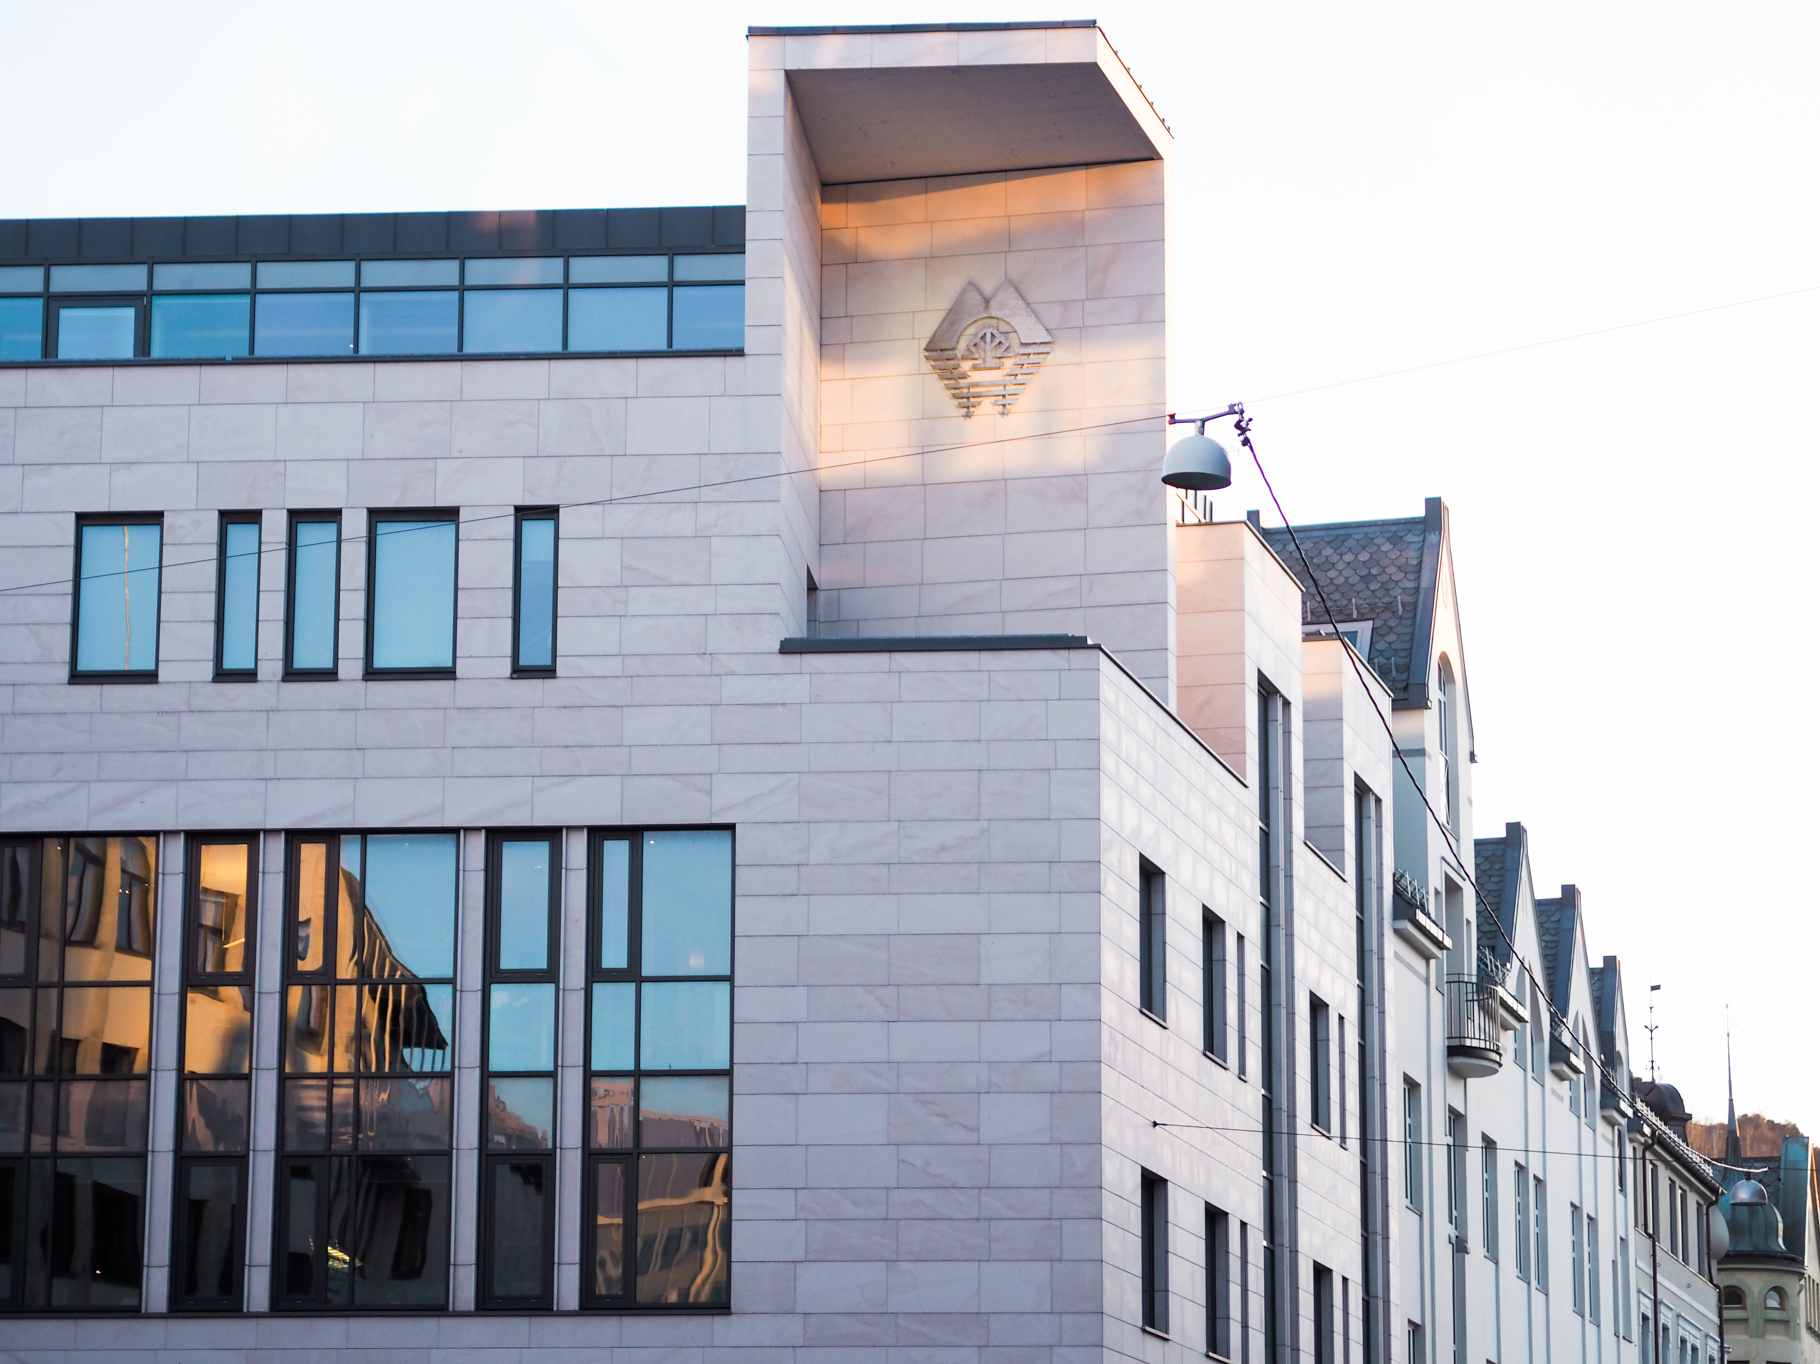
Finansielle resultat
Results

Slide 8
A good start to 2018
Improved results compared with H1 2017
Result after taxation
Return on Equity
- NOK million
- in percent (ROE)

Slide 9
Growth in income, stable cost level and low losses
H1 2018 compared with H1 2017
Higher Net Interest Income in NOK
Higher level of Other Income
Stable operating costs
Low level of losses also in H1 2018

Slide 10
Results
Statement of income H1 2018 – The Group
 | H1 2018 |  | H1 2017 |  | Changes
Results (NOK million and %) | NOK | % | NOK | % | NOK | p.p. | %
Net Interest Income | 580 | 1.71 | 529 | 1.69 | 51 | 0.02 | 9.6
Net Income Financial Investments | 22 | 0.06 | 20 | 0.06 | 2 | 0.00 | 10.0
Gains/losses liquidity portfolio | -3 | -0.01 | 22 | 0.08 | -25 | -0.09 | -
Gains/losses on shares | 13 | 0.05 | -5 | -0.02 | 18 | 0.07 | -
Other Income | 99 | 0.29 | 92 | 0.30 | 7 | -0.01 | 7.6
Total Other Income | 131 | 0.39 | 129 | 0.42 | 2 | -0.03 | 1.6
Total Income | 711 | 2.10 | 658 | 2.11 | 53 | -0.01 | 8.1
Personnel costs | 169 | 0.50 | 170 | 0.54 | -1 | -0.04 | -0.6
Other costs | 130 | 0.38 | 131 | 0.42 | -1 | -0.04 | -0.8
Total operating costs | 299 | 0.88 | 301 | 0.96 | -2 | -0.08 | -0.7
Profit before losses | 412 | 1.22 | 357 | 1.15 | 55 | 0.07 | 15.4
Losses on loans, guarantees etc | -3 | -0.01 | 8 | 0.03 | -11 | -0.04 | -
Pre tax profit | 415 | 1.23 | 349 | 1.12 | 66 | 0.11 | 18.9
Taxes | 100 | 0.29 | 88 | 0.27 | 12 | 0.02 | 13.9
Profit after taxation | 315 | 0.94 | 261 | 0.85 | 54 | 0.09 | 20.6

Slide 11
Balance sheet and key figures
 | 30.06.2018 | 30.06.2017 | Changes
Balance in NOK million | NOK | NOK | NOK | %
Total Assets | 70,578 | 65,652 | 4,926 | 7.5
Loans to customers | 58,869 | 56,040 | 2,829 | 5.0
Deposits from customers | 34,239 | 33,514 | 725 | 2.2
Net Equity and Subordinated Loans | 6,477 | 6,534 | -57 | -0,9
Key Figures |  | 30.06.2017 | Changes p.p.
 | 30.06.2018
Return on Equity | 11.2 | 10.0 | 1.2
Cost/Income Ratio | 42.1 | 45.7 | -3.6
Total Capital | 19.1 | 18.9 | 0.2
Tier 1 Capital | 17.1 | 16.9 | 0.2
CET1 | 15.5 | 14.3 | 1.2
Leverage Ratio | 8.0 | 8.3 | -0.3
Results per EC (NOK, the Group) | 15.45 | 13.10 | 2.35
Results per EC (NOK, the Bank) | 18.40 | 17.60 | 0.80

Slide 12
Quarterly development in Net Interest Income
Increased NII in NOK, lower in per cent
Net Interest Income
Net Interest Income
- NOK million
- % of Average Assets

Slide 13
Quarterly development in Other Income
Negative effects from financial instruments
Other Income
Other Income
- NOK million
- % of Average Assets
The updated value measurement following the merger between Vipps, Bank Axept and BankID Norge gave a profit effect of approximately MNOK 10 for the second quarter of 2018
Market value of the liquidity portfolio is reduced by NOK 11 million compared with H1 2017
Continued good growth in our Discretionary Portfolio Management Department contributes positively during the quarter

Slide 14
Total Income
Good income growth compared to second quarter 2017
Total Income
Total Income
- NOK million
- % of Average Assets

Slide 15

Strong cost control – improved efficiency
Positive development
Operating Costs
Operating Costs
- NOK million
- % of Average Assets
Cost/Income ratio
Total Assets and Man Years
- Total Assets in NOK billion

Slide 16
Strong underwriting
Persistent low losses
Losses on loans and guarantees
Losses on loans and guarantees
- NOK million
- % of Average Assets
Losses on loans and guarantees
Losses on loans and guarantees
- NOK million
- % of Average Assets

Slide 17
Losses by sector
Losses on loans and guarantees
- NOK million
The expected credit loss (ECL) model is compliant with IFRS 9 and is used to calculate losses
Total calculated ECL by second quarter end is NOK 5 million lower than by 1.1.2018
Individual impairments and other losses of NOK 4 million for retail customers and NOK -2 million for corporate customers
Total losses are -NOK 3 million by half year end

Slide 18
Impairments
High and comfortable levels
Impairments
Impairments
- NOK million
- % of Gross Loans

Slide 19
Problem Loans and Impairments
Low level of problem loans and good coverage
Problem Loans and Impairments (per cent)
Problem Loans are loans and guarantees more than 90 days over due and performing loans with individual impairments.

Slide 20
Pre tax profit
Strong quarterly development
Profit after losses
Profit after losses
- NOK million
- % of Average Assets

Slide 21
Finansielle resultat
Balance sheet

Slide 22
Continued good growth
Strong loan growth and high deposit-to-loan ratio
Loans
Deposits
- NOK billion and per cent (y/y)
- NOK billion and per cent (y/y)
Customer lending has increased by 5.0 % over the last 12 months
Deposit growth of 2.2 % over the last 12 months
High deposit-to-loan ratio of 58.2 %

Slide 23
Lending
Good growth both to the retail and to the corporate market
Retail market
Corporate market
- NOK billion and per cent y/y
- NOK billion and per cent y/y
Retail lending has increased by 5.6 % over the last 12 months
Loans to the retail market amount to 69.0 % of total loans
Corporate lending has increased by 4.2 % over the last 12 months
Loans to the corporate market amount to 31.0 % of total loans

Slide 24
Diversified loan book
Loans by sector
Other:
Financial services | 2.1 % | Agriculture | 0.8 %
Other Industry | 1.6 % | Fishing Industry | 1.3 %
Building and construction | 1.2 % | Furniture | 0.1 %
Ship Yards | 1.0 % | Other | 0.4 %
Retail/wholesale trade | 1.1 %

Slide 25
Good quality in our retail portfolio
High proportion of secured loans
Loans to retail customers
Loan to value – retail loans
- % of total loans
The bank complies with the regulations from the Norwegian authorities (Boliglånsforskriften)
Deviations reported in the second quarter of 2018 were 4.3 % outside Oslo, and 4.9 % in Oslo
96.3 % of mortgage-backed loans to retail customers are within 85% of value

Slide 26
House prices
- Development from January 2008 to June 2018
Development in house prices
Development in house prices
- Index – Jan 2008 = 100
- Average per square meter price
Key information (Sold pre-owned dwellings) | Norway | Mid-Norway** | Greater Ålesund* | Greater Stavanger* | City of Oslo
Price development last 12 months | +1.5 % | +0.4 % | +0.9 % | -0.3 % | +1.6 %
Price per square meter (NOK) | 40,976 | 33,700 | 29,245 | 35,025 | 69,060
Average days on market (DOM) sold units in June 2018 | 38 days | 50 days | 65 days | 61 days | 21 days
Price median dwelling (NOK) | 3,108,688 | 2,730,000 | 2,550,000 | 3,250,000 | 3,951,017
*Ålesund and Stavanger including surrounding municipalities
** Mid-Norway including the county of Møre og Romsdal and the county of Trøndelag

Slide 27
Deposits
Growth in deposits over the last 12 months
Retail market
Corporate and public
- NOK billion and per cent y/y
- NOK billion and per cent y/y
Retail deposits have increased by 3.9 % over the last 12 months
Deposits from the retail market amount to 60.9 % of total deposits
Deposits from corporate and public customers have increased by 0.6 % the last 12 months and ended at NOK 12.6 billion by quarter end

Slide 28
Discretionary Portfolio Management
Strong growth - close to NOK 4,4 billion under management
Sparebanken Møre - Aktiv Forvaltning
- Portfolio in NOK million
In addition to deposits, increasingly more of the Sparebanken Møre`s customers also ask for other investments
Sparebanken Møre Aktiv Forvaltning (Discretionary Portfolio Management) offers the Bank's clients professional management services
Our local Asset Managers continuously monitor the portfolio:
    9 municipalities
    10 foundations
    1 pension fund
    2 insurance companies
    156 investment companies
    204 wealthy private individuals

Slide 29
Finansielle resultat
Liquidity and Capital

Slide 30
Deposits from customers and market funding
Deposits are the Group`s most important source of funding
Deposits and market funding
Sparebanken Møre with good access to the market – diversifying the investor base
- NOK million
Total net market funding ended at NOK 28.5 billion by quarter end – close to 85 per cent with remaining maturity of more than one year
The bank has very strong liquidity at the end of H1 and sufficient surplus to meet balance sheet growth and refinancing in the third quarter without compromising the fulfillment of key figures for liquidity and financing
Senior Bonds: Weighted average maturity of 2.44 years (FSA defined key figures)
Covered Bonds issued through Møre Boligkreditt AS have a weighted average maturity of 3.88 years (FSA defined key figures)
Møre Boligkreditt AS has issued eight loans qualifying for Level 2A liquidity in LCR. In June this year, the mortgage company issued it’s second sub-benchmark Public Issue of EUR 250 million in the European market, the first issued last summer
June 14 this year, Moody`s confirmed the bank's A2- stable rating. Issuances from Møre Boligkreditt AS are rated Aaa

Slide 31
Equity and related capital
Capital and leverage ratio (LR) well above regulatory requirements
Tier 1 capital in Sparebanken Møre
CET 1 requirement for Sparebanken Møre
- % of risk weighted assets
- % of risk weighted assets
By quarter end our Common Equity Tier 1 capital stood at 15.5%, Tier 1 capital at 17.1 % and total capital at 19.1 %
Sparebanken Møre’s capital targets are:
  Total Capital: Minimum 18.3 %
  Tier 1 capital: Minimum 16.3 %
  CET1: Minimum 14.8 %
The Group's Capital shall follow the announced regulatory capital escalation plan
Our capital is calculated according to the IRB Foundation Approach for corporate commitments, IRB Approach for the retail market

Slide 32
Equity Capital in Sparebanken Møre
MORG – price and Price/Book (P/B) value
Dividend Policy
Sparebanken Møre aims to achieve financial results providing a good and stable return on the Bank’s equity capital
Sparebanken Møre’s results should ensure that the owners of the equity receive a competitive long-term return in the form of cash dividends and capital appreciation on their equity
Unless the capital strength dictates otherwise, about 50% of the profit for the year will be distributed as dividends
Sparebanken Møre’s allocation of earnings shall ensure that all equity owners are guaranteed equal treatment
Equity per MORG is calculated on Group figures

Slide 33
Equity Capital in Sparebanken Møre
Dividend and EC-price
The PCCs/ECs of Sparebanken Møre (MORG) have been listed at Oslo Stock Exchange since 1989
Total EC capital NOK 989 million by June 2018
Good return – Total Return for Sparebanken Møre is 5 per cent higher than the EC index in H1
Annual dividend per EC
1990 | 10 | 2005 | 20
1991 | 0 | 2006 | 20
1992 | 0 | 2007 | 23
1993 | 13 | 2008 | 20
1994 | 12 | 2009 | 12
1995 | 13 | 2010 | 12
1996 | 13 | 2011 | 8
1997 | 13 | 2012 | 12
1998 | 15 | 2013 | 8
1999 | 16 | 2014 | 13.50
2000 | 17 | 2015 | 11.50
2001 | 17 | 2016 | 14.00
2002 | 15 | 2017 | 14.00
2003 | 16
2004 | 18

Slide 34
Equity Capital in Sparebanken Møre
About equity certificates
Equity certificates are a special kind of equity instrument first introduced by savings banks in 1988. A total of 32 banks have now issued such certificates, and 19 of them are listed on the stock exchange
Equity certificates are an important part of savings banks’ capital base and confer ownership of between 14 % and 97 % of the individual bank
A savings bank that has issued equity certificates has two types of equity. One is its primary capital, or “ownerless” equity, consisting of retained earnings built up by the bank over the years. The other is the certificate-holders’ equity, consisting of equity certificate capital and related reserves (equalization reserve and premium account)
Equity certificates have clear similarities to shares. The main differences lie in their owners’ rights to the bank’s assets and influence over the bank’s governing bodies. The key principle is that profits are distributed proportionally on the basis of ownership share and the bank’s other capital
In a limited company, losses hit shareholders’ equity directly. In a savings bank, losses are first absorbed by the primary capital and the equalization reserve before hitting the equity certificate capital
Source: The Norwegian Savings Bank Association https://www.sparebankforeningen.no/en/egenkapitalbevis/about-equity-certificates/

Slide 35

Utsiktene fremover
GOALS IN OUR STRATEGIC PLAN «Møre 2022» for the period 2018-2022
CET1 > 14.8 %
Cost/Income < 40 %
ROE > 11 %
Low level of losses
Healthy financial structure
We achieve our goals.

Slide 36
Trond Lars Nydal, CEO
+47 951 79 977
trond.nydal@sbm.no
Runar Sandanger, EVP
+47 950 43 660
runar.sandanger@sbm.no

Slide 37
Disclaimer
This presentation does not constitute or form part of and should not be construed as, an offer to sell or issue or the solicitation of an offer to buy or acquire securities of Sparebanken Møre (the “Company”), in any jurisdiction or an inducement to enter into investment activity. No part of this presentation, nor the fact of its distribution, should form the basis of, or be relied on in connection with, any contract or commitment or investment decision whatsoever. If any such offer or invitation is made, it will be done so pursuant to separate and distinct documentation in the form of a prospectus, offering circular or other equivalent document (a "prospectus") and any decision to purchase or subscribe for any securities pursuant to such offer or invitation should be made solely on the basis of such prospectus and not these materials.
This presentation has been prepared solely for use in connection with the presentation of the Company. The information contained in this document is strictly confidential and is being provided to you solely for your information and cannot be distributed to any other person or published, in whole or in part, for any purpose. It may not be reproduced, redistributed, passed on or published, in whole or in part, to any other person for any purpose. Failure to comply with this and the following restrictions may constitute a violation of applicable securities laws. No representation, warranty or undertaking, express or implied, is made as to, and no reliance should be placed on, the fairness, accuracy, completeness or correctness of the information or the opinions contained herein. None of the Company or any of their respective affiliates, advisors or representatives shall have any liability whatsoever (in negligence or otherwise) for any loss howsoever arising from any use of this presentation or its contents or otherwise arising in connection with the presentation.
These materials are not intended for distribution to, or use by any person or entity in any jurisdiction or country where such distribution or use would be contrary to local law or regulation. In particular, these materials (a) are not intended for distribution and may not be distributed in the United States or to U.S. persons (as defined in Regulation S) under the United States Securities Act of 1933, as amended and (b) are for distribution in the United Kingdom only to (i) investment professionals falling within Article 19(5) of the Financial Services and Markets Act 2000 (Financial Promotion) Order 2005 (the “Order”) or (ii) persons falling within Article 49(2)(a) to (d) (“high net worth companies, unincorporated associations etc”) of the Order.”
Investors may get back less than they invested. The Company gives no assurance that any favourable scenarios described are likely to happen, that it is possible to trade on the terms described herein or that any potential returns illustrated can be achieved.
This document offers no investment, financial, legal, tax or any other type of advice to, and the Company has no fiduciary duties towards, any recipients and therefore any such determination should involve, inter alia, an assessment of the legal, tax, accounting, regulatory, financial, credit and other related aspects of the securities or such transaction. The Company makes no representation nor gives any warranty as to the results to be obtained from any investment, strategy or transaction, nor as to whether any strategy, security or transaction discussed herein may be suitable for recipients’ financial needs, circumstances or requirements. Recipients must make their own assessment of such strategies, securities and/or potential transactions detailed herein, using such professional advisors as they may require. No liability is accepted for any direct or consequential losses arising from any action taken in connection with or reliance on the information contained in this document even where advised of the possibility of such losses.

