Slide 1
Allocation & Impact report
Green Bond Framework
Ålesund
As at 31.12.2025

Slide 2
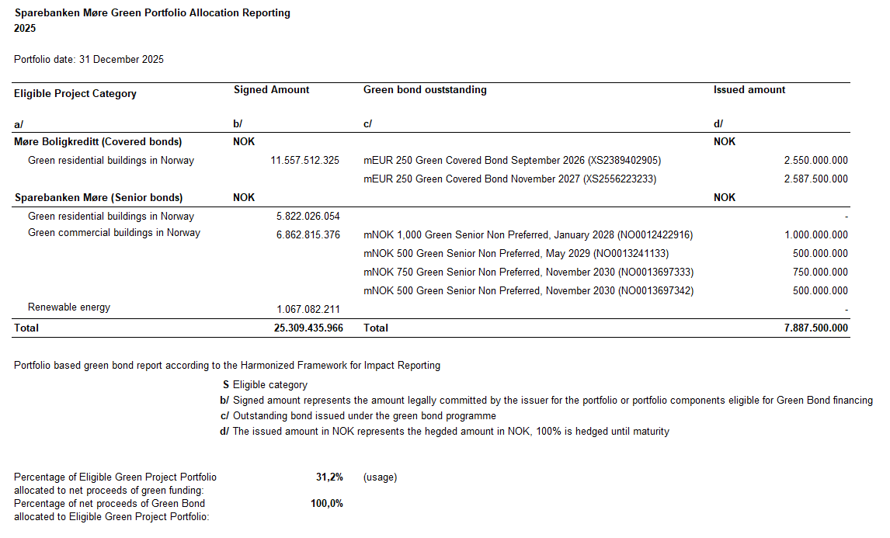

Slide 3
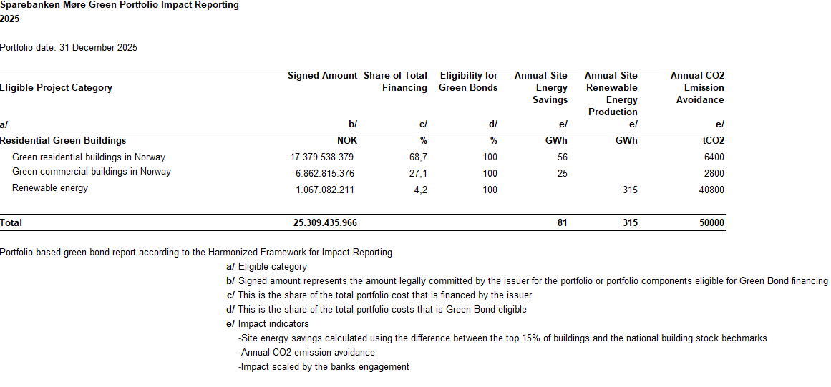
Sett inn impact report

